Slide 1
Quick Serve – Localized Service Discovery and Booking App
Presented By :- (TEAM C)
Venkata siva Ragala
Dwarapureddy Sandeep
Madhu Sri Nissankararao
Sowmiya B
Shaik Aslam Basha
Nihal Aftab
Sakil Ahmed

Slide 2
Outline
Introduction
Problem Statement
Objectives
Hardware & software requirements
Non - Functional Requirements
Functionality of Service Spot
Methodology
System Architecture/ Proposed Work Diagram
Benefits of Service Spot
Conclusion
Any Doubts & suggestions
Thank you

Slide 3

Introduction
Have you ever needed a nearby service provider but didn’t know whom to contact? Quick serve is planned to make this easier by helping people quickly find and book local services in one place. The goal is to create a simple and practical solution to a common everyday problem.

Slide 4
Problem Statement
In daily life, people struggle to find reliable nearby service providers quickly. Traditional search methods (local shops, word-of-mouth) are slow and lack transparency in pricing and availability. Service providers also lack a digital presence to reach customers efficiently.
There is a need for a platform that connects users with verified local service providers in real time.

Slide 5
Objectives
Compare services
simple & secure booking
digital presence services
real-time service management
user-friendly interface
Service Spot
Provide a user-friendly interface to search local services
Help users compare providers based on rating, cost, and distance
Offer simple & secure booking system
Build a digital presence for small/local service businesses
Enable real-time service management (status, history, notifications)

Slide 6
Hardware & Software Requirements

Slide 7

HARDWARE REQUIREMENTS:
RAM & SSD:8GB, 512 SSD
Processor:i5 or above (or equivalent)

Slide 8
IntelliJ IDEA / Eclipse
Postman (API testing)
IntelliJ IDEA / Eclipse
Postman (API testing)
Software Requirements
Frontend: HTML, CSS, JavaScript Backend: Java (spring boot), Jakarta persistence API, hibernate Database: MySQL
IDE's: IntelliJ, Eclipse, Postman, VsCode Version Control: Git & GitHub
Other Tools: spring tool suite (STS), maven Server: Apache tomcat (embedded in spring boot) Environment: JDK 21, windows Browser: chrome, Firefox, or edge

Slide 9
Non-Functional Requirements
Security : protected credentials, data privacy
Performance : fast search responses
Scalability : can handle more users in future
Reliability : data consistency and uptime
Reliability
Security
Performance
Scalability

Slide 10
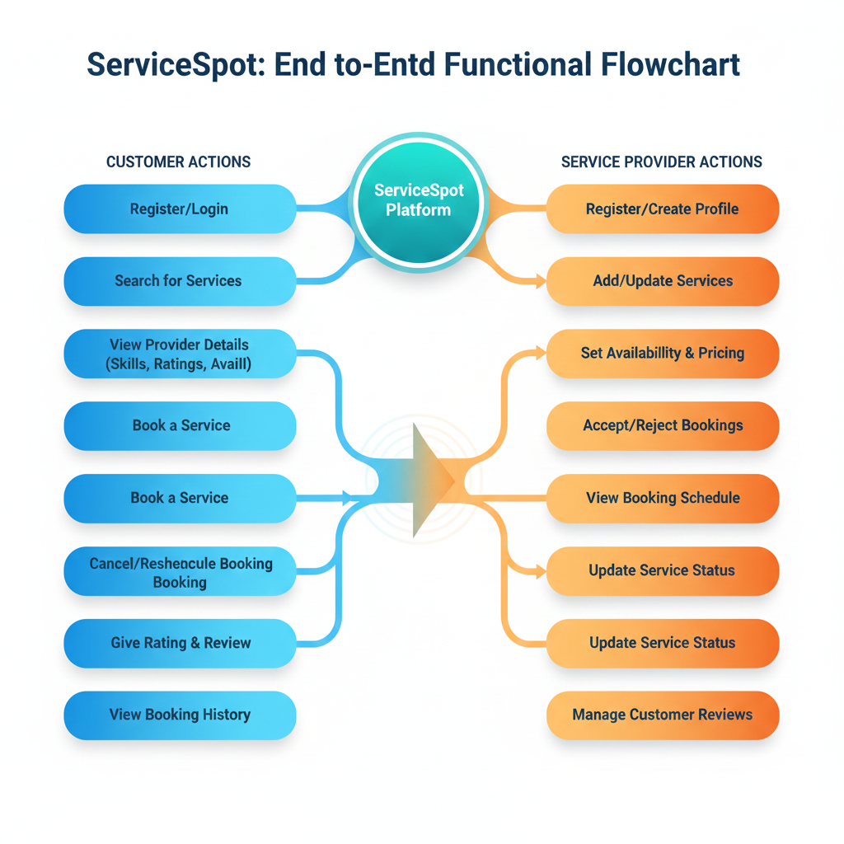
Functionality of Service Spot

Slide 11
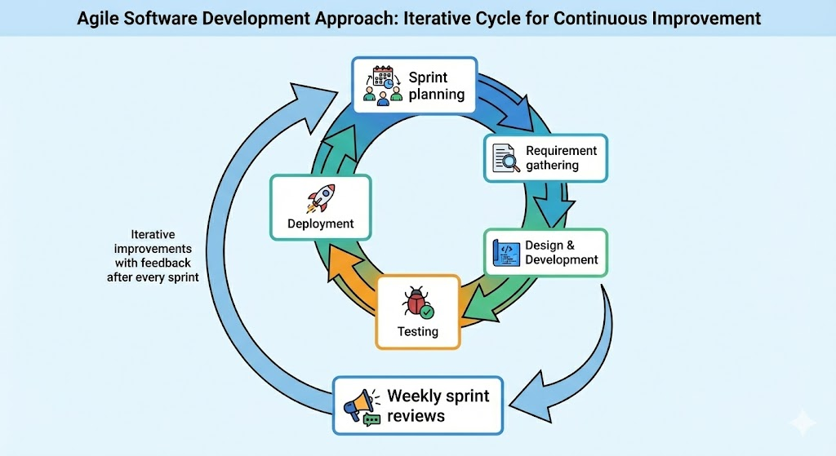
Methodology

Slide 12
System Architecture/Proposed work Block diagram
End users
Service Providers
Service Consumers
Frontend (UI)
HTML,CSS,JS
Login , Registration
Backend(Java- Spring-Boot)
User Authentication
Server
Database(MySQL)
Review ,Feedback
Updating services
Business Logic
Apache Tomcat
Http Request & Http Response
Bridge For frontend & Backend
Providers
Consumers
Booking Table
Profile setting

Slide 13
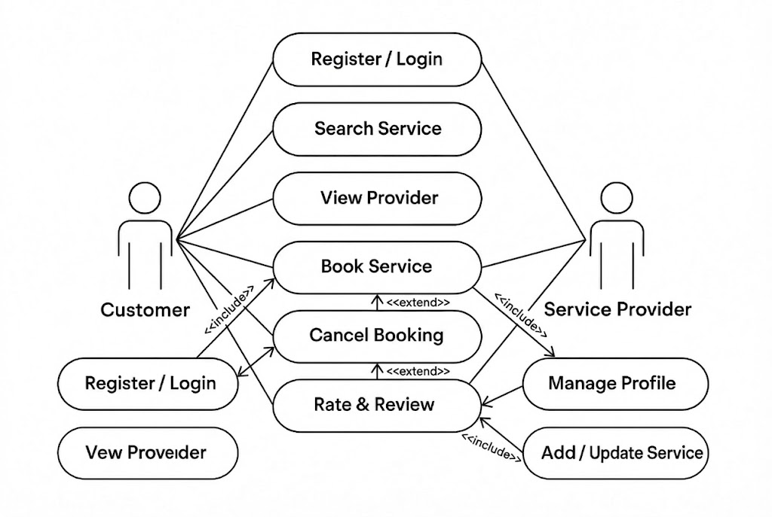
Use case Diagram

Slide 14
Benefits of Service Spot
Benefits of Service Spot
Quick discovery of local services
Easy booking & secure payments
Ratings & reviews for trust
Increased visibility for providers
Efficient appointment management
Scalable & revenue-generating platform
Supports local economy & community

Slide 15
Conclusion
The Quick serve localized service discovery and booking app provides a seamless platform connecting users with reliable local service providers. It enhances convenience, trust, and efficiency for customers, while enabling service providers to increase visibility and manage operations effectively. The scalable and user-friendly solution not only drives business growth but also supports the local economy, fostering a stronger and more connected community. Quick serve exemplifies how technology can simplify daily life while empowering both users and service providers.

Slide 16

Any doubts && suggestions?

Slide 17

Thanks for Listening

